Slide 1
Mservice Care App (Beta)
Test Report

Slide 2
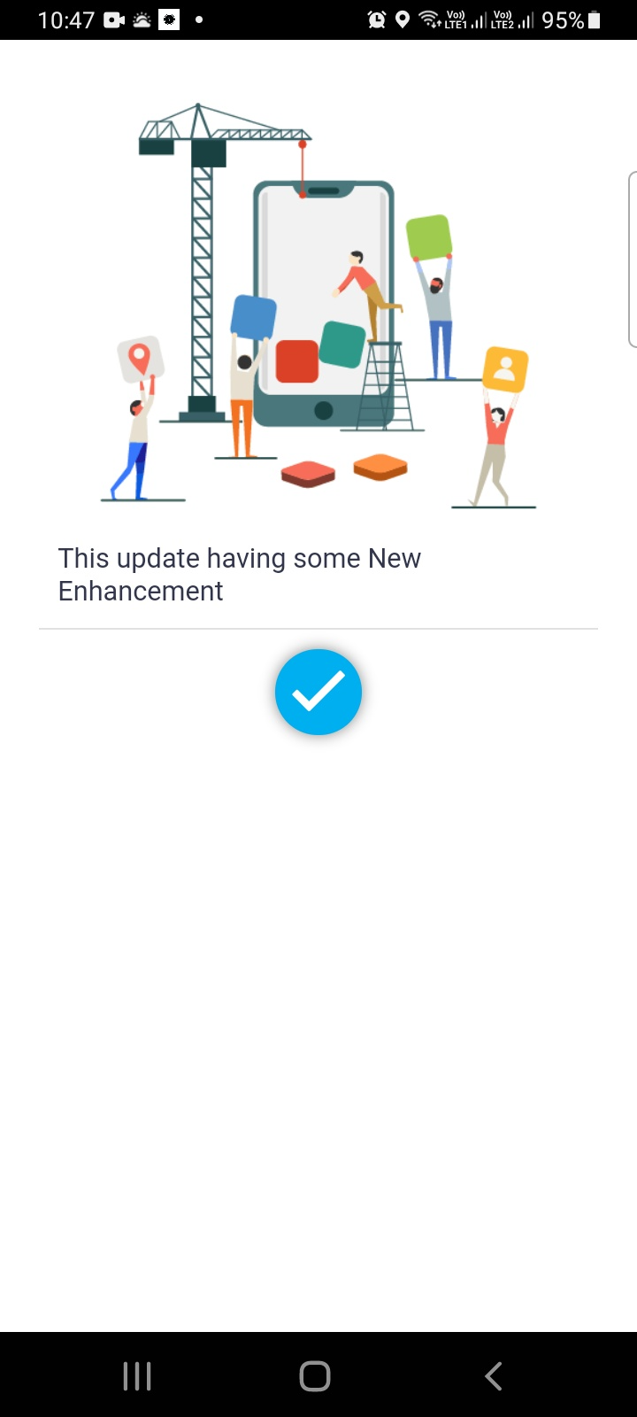
Query Creator : Abhishek
Assignee : Kamalesh
This screen is showing while reopening the app when it stopped responding & new message/attachment notification was working properly at that moment.

Slide 3
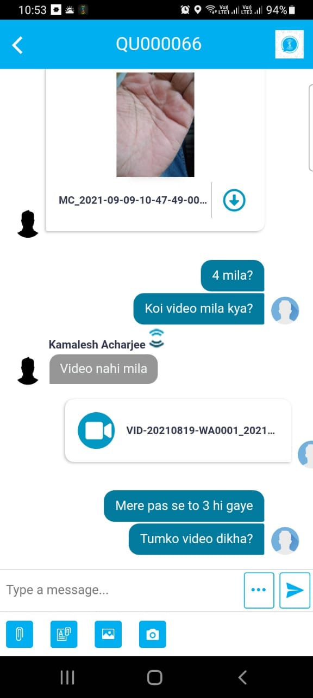
This spinner keeps on rotating when we tried to send any .mp4 video that is more than 5mb & the app stops responding at the same time. It is not showing any error message as well. And also the app is not supporting all .mp4 files.

Slide 4
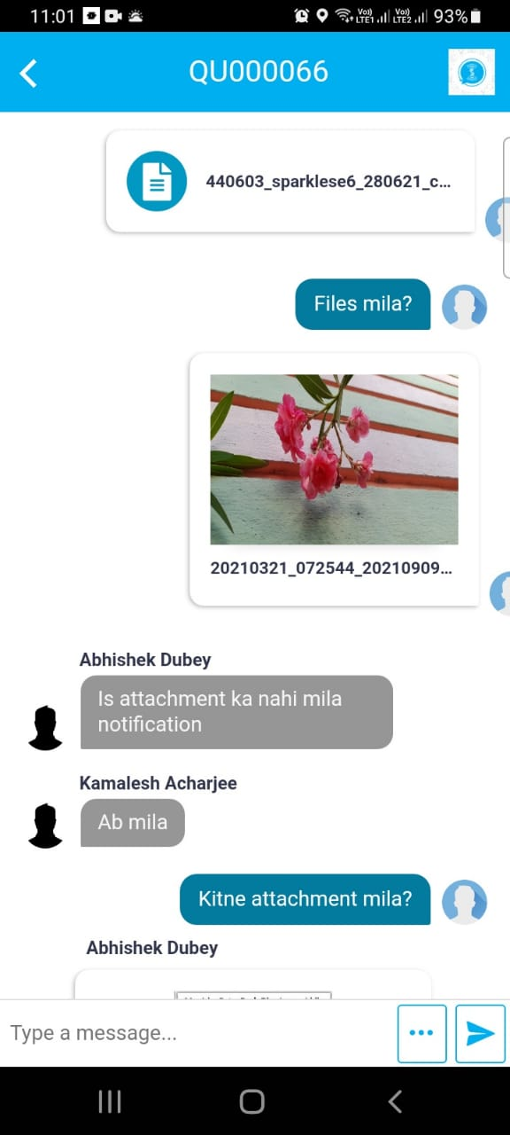
The app is showing my name instead of Abhishek in middle of a conversation

Slide 5
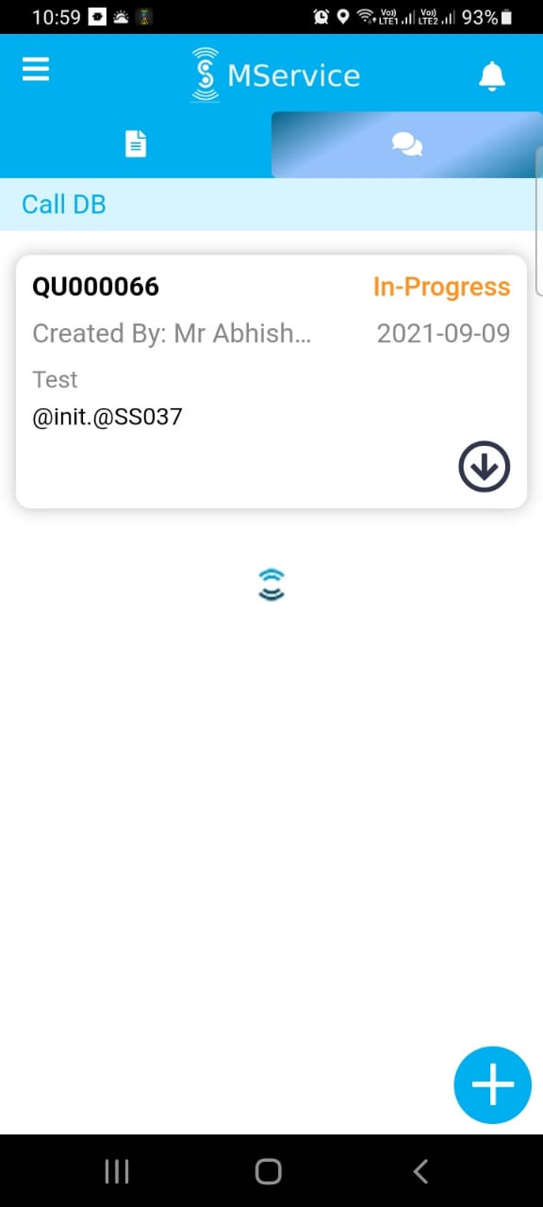
In call DB page, the spinner appeared suddenly & the app stopped responding

Slide 6
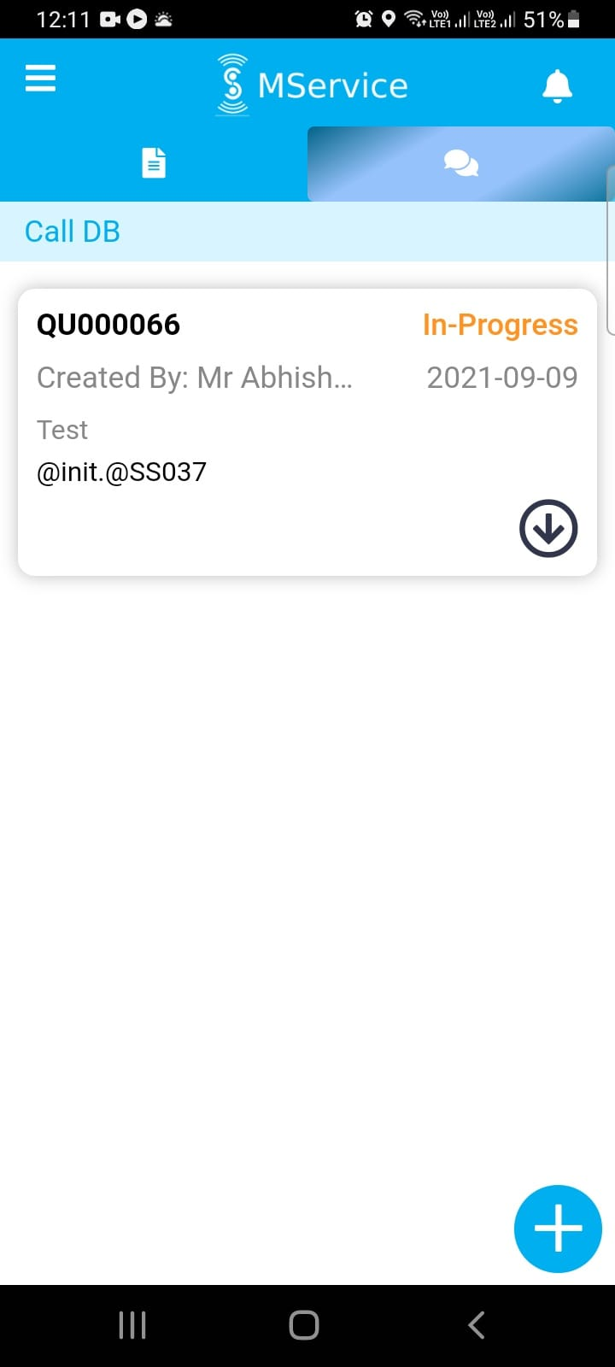
Query creation option is not required for Assignee

Slide 7
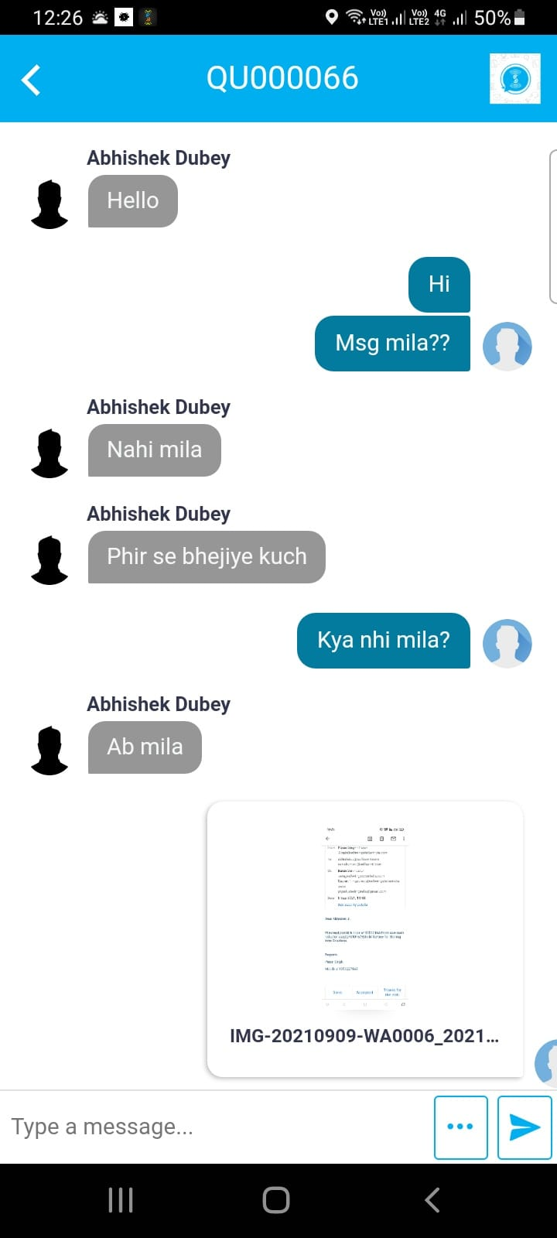
Not able to see chat date and time

Slide 8
Other Corrections:
The web (SIT) needs to be enabled to track the tickets.
The push notifications are working only when app minimized from Knowledge base tab. It should work in all scenarios(app minimized/closed/kill from any tab).
Upload of .mp4 file size should be increased to 25mb instead of 5mb.

Slide 9
Thank You

